Slide 1

Investing in AirBnb
By: Yasser Al Garni - Faisal Yousef

Slide 2

Introduction
Why
How
What

Slide 3

Why
James would like invest
So much data its confusing
Analyze and Recommend

Slide 4
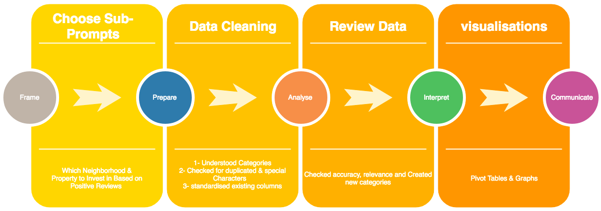
How

Slide 5
Data Interpreting
Property Count
Columbia Heights
Dupont Circle
Capital Hill

Slide 6
Data Interpreting
Neighborhood Reviews
Cleveland Park
Woodland/Fort Stanton
Spring Valley
Notes:
Average is at 92.5

Slide 7
Data Interpreting
Property Reviews
Highest Risk
Lower Risk
Lowest Risk
Notes:
Ave is 98.13

Slide 8



Thank you for your attention, and special thanks to Misk Academy for this great opportunity!

